Slide 1



DiG-In-GNN: Discriminative Feature Guided GNN-based Fraud Detector against Inconsistencies in Multi-Relation Fraud Graph
Jinghui Zhang, Zhengjia Xu*, Dingyang Lv*, Zhan Shi, Dian Shen, Jiahui Jin, Fang Dong Southeast University
* Corresponding authors

Slide 2
Outline
Background and Challenges
Method: DiG-In-GNN
Experiments
Conclusion and Future Work

Slide 3
Background
Rating Star to Products within a week
Linguistically similar users
User 1
Products
User 2
User 3
U-P-U
User 4 (Fraudster)
U-S-U
U-V-U
Linguistically similar users
(a) a scenario of e-commerce
(b) a multi-relation graph

Slide 4
Background
Rating Star to Products within a week
Linguistically similar users
User 1
Products
User 2
User 3
U-P-U
User 4 (Fraudster)
U-S-U
U-V-U
Linguistically similar users
(b) a multi-relation graph
(a) a scenario of e-commerce
Nodes can be connected by multiple edges of different types, representing various entity relationships, to represent more complex information!

Slide 5
Challenges
Fraudsters imitate benign reviews to camouflage
feature inconsistency
Impairs the effectiveness of GNN

Slide 6

Challenges
Fraudsters interact with benign nodes
Fraudsters imitate benign reviews to camouflage
Edges connect the fraudsters to the benign nodes
feature inconsistency
structural inconsistency
Impairs the effectiveness of GNN
Impairs the effectiveness of GNN

Slide 7
Challenges
structural inconsistency
+
feature inconsistency

Slide 8
Method: DiG-In-GNN
# To dig into graphs for fraudster.

Slide 9

Method: DiG-In-GNN
# To dig into graphs for fraudster.

Slide 10
Method: DiG-In-GNN
# To dig into graphs for fraudster.

Slide 11
Method: DiG-In-GNN
# To dig into graphs for fraudster.

Slide 12
Experiments
# To dig into graphs for fraudster.

Slide 13
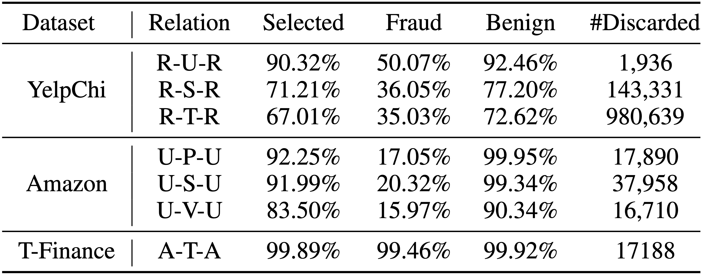
Experiments
# To dig into graphs for fraudster.

Slide 14
Conclusion and Future Work
In this paper, we present a multi-relation graph-based fraud detector. Enhanced by the guidance node and RL-based fine- grained neighbor selection, DiG-In-GNN solves two inconsistency problems in the fraud graphs. Experiments on three public datasets demonstrate the effectiveness of our method. For future work, generalizing DiG-In-GNN to multi-class node classification could be a promising direction.
# To dig into graphs for fraudster.

Slide 15

E-mail: { jhzhang, xzhengjia, dylv, shizhan }@seu.edu.cn
Code: https://github.com/GraphBerry/DiG-In-GNN
GraphBerry: https://github.com/GraphBerry

